Slide 1


Slide 2
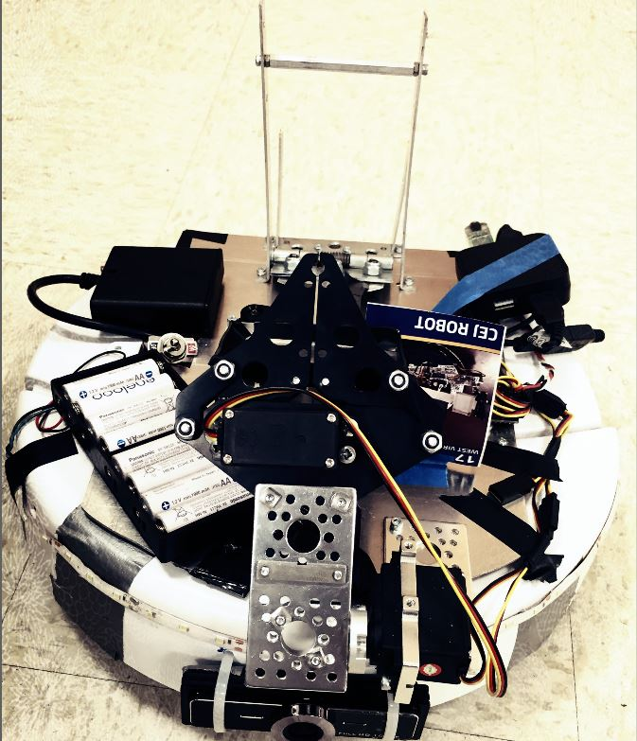

Mercury Remote Robot Challenge
C.E.J Robot
Caleb Azonsi
Olujide Jacobs
Edwin Mann

Slide 3
Problem Statement
Design a robot capable of roving a track at Oklahoma State University
To be operated from at least 50 miles away via the Internet.
The robot must also be capable of performing a mission, which includes picking up a bean bag and launching at target.

Slide 4
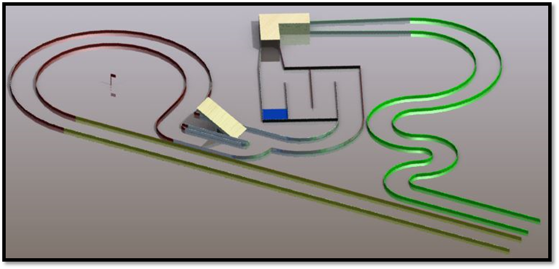
2015 Competition Track

Slide 5
Goals/Objectives
Choose and Manipulate Vehicle Base
Hack Roomba
Build Arm Mechanism
Program Arm to raise, and lower via control
Build and program Gripper
Create shaft plate for shock absorbing

Slide 6
Goals/Objectives
Build catapult mechanism
Program catapult to set and release via control
Hack Roomba Sensors
Create Circuits to power servos and headlights

Slide 7
Goals/Objectives
Select Cameras
Provide video feed from robot to base station
Program loss of signal pointer to robot
Finalize Robot trimming and testing

Slide 8
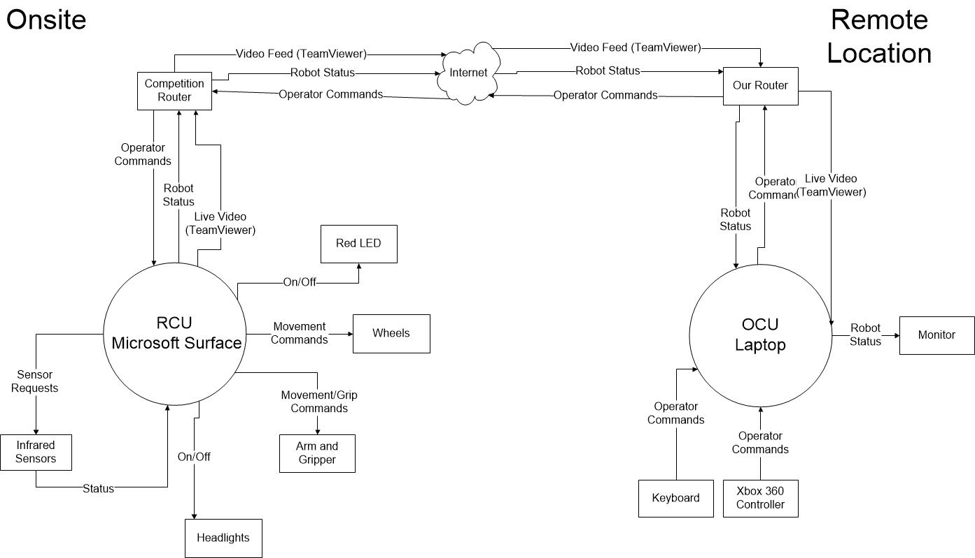
GENERAL ARCHITECTURE

Slide 9
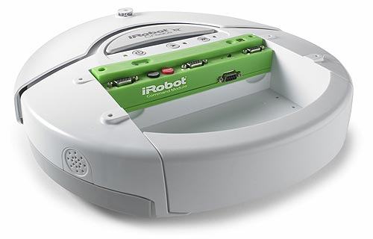
HARDWARE USED

Slide 10
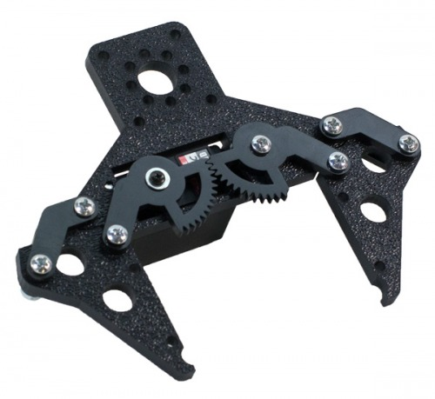

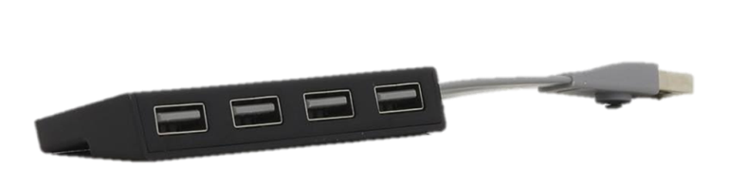
HARDWARE USED

Slide 11
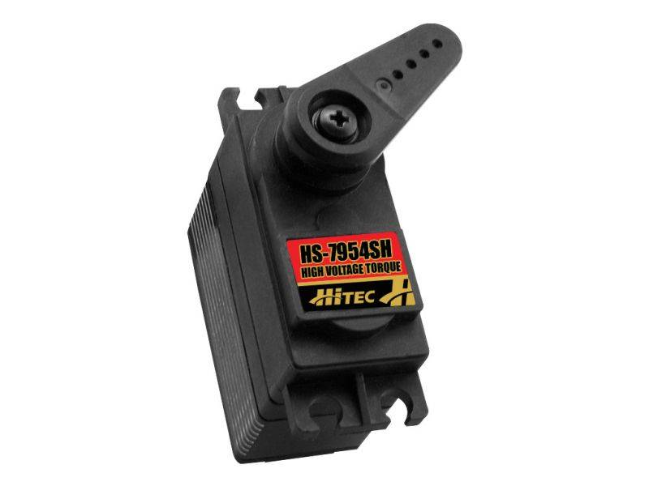
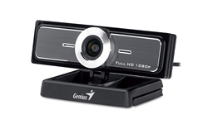
HARDWARE USED

Slide 12
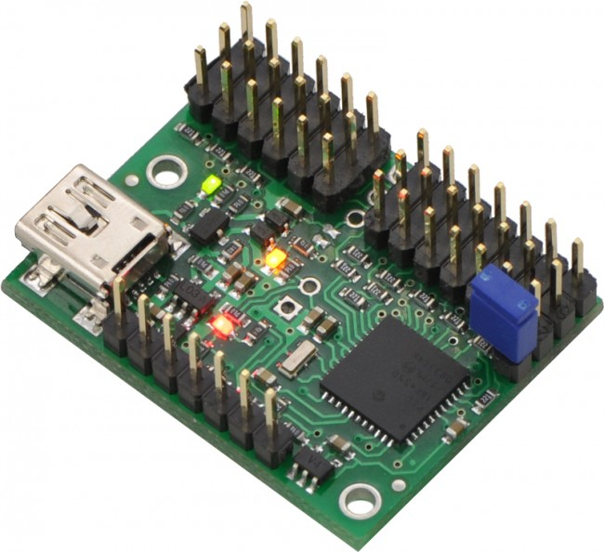
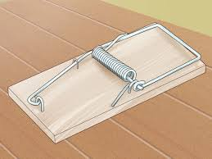
HARDWARE USED

Slide 13
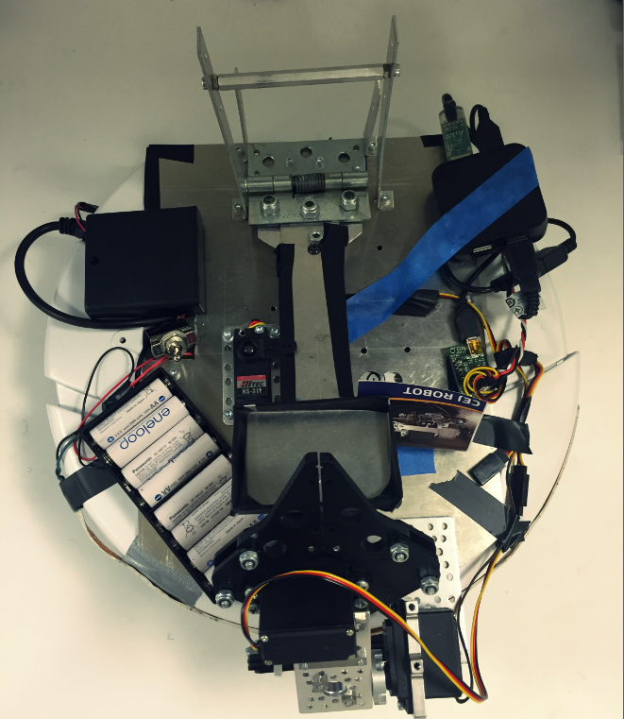
ROBOT ASSEMBLED

Slide 14
BLOCK DIAGRAM

Slide 15
VIDEO FEED

Slide 16
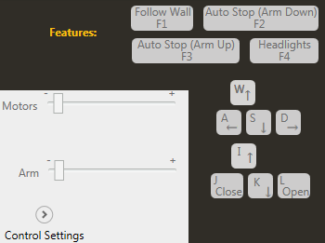
CONTROL

Slide 17
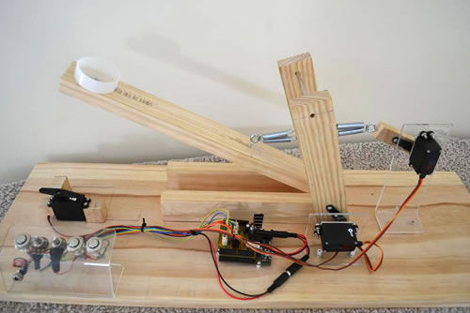
CATAPULT

Slide 18
ACCOMPLISHMENT
Construction objectives were met
We passed the loss of signal test
Navigated the track, but had signal failure during pick up
Team Mountaineers took 3rd Place Overall!

Slide 19
FUTURE SUGGESTIONS FOR IMPROVEMENT
· Make robot more portable
· Program automated movement and sensory
· Create neater and more reliable electrical circuits

Slide 20



